Slide 1
Make a copy of this template to get started.
LINKS TO RESOURCES REFERENCED
Page 1
National Outdoor Learning Library
Outdoor Infrastructure Planning Strategies (PDF)
Health Guidance
Campus Assessment Tool (PDF)
Campus Assessment Tool (MS Word)

Slide 2
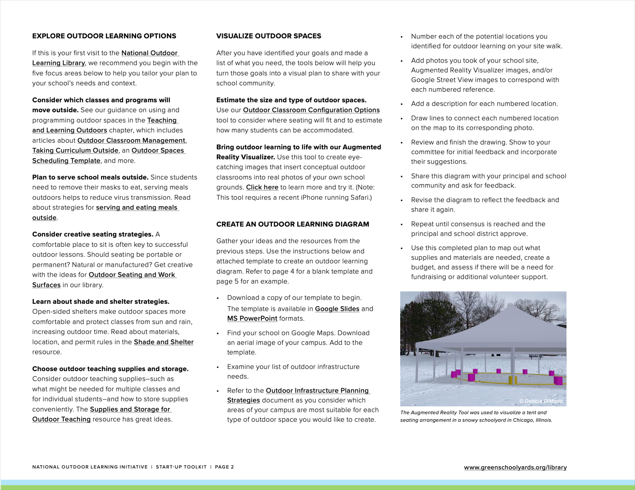
LINKS TO RESOURCES REFERENCED
Page 2
National Outdoor Learning Library
Teaching and Learning Outdoors
Outdoor Classroom Management
Taking Curriculum Outside
Outdoor Spaces Scheduling Template
Outdoor Meals
Outdoor Seating and Work Surfaces
Shade and Shelter
Supplies and Storage for Outdoor Teaching
Outdoor Classroom Configurations Options
Augmented Reality Visualizer
Outdoor Learning Diagram Template (Google Slide)
Outdoor Learning Diagram Template (MS Power Point)
Outdoor Infrastructure Planning Strategies (PDF)

Slide 3
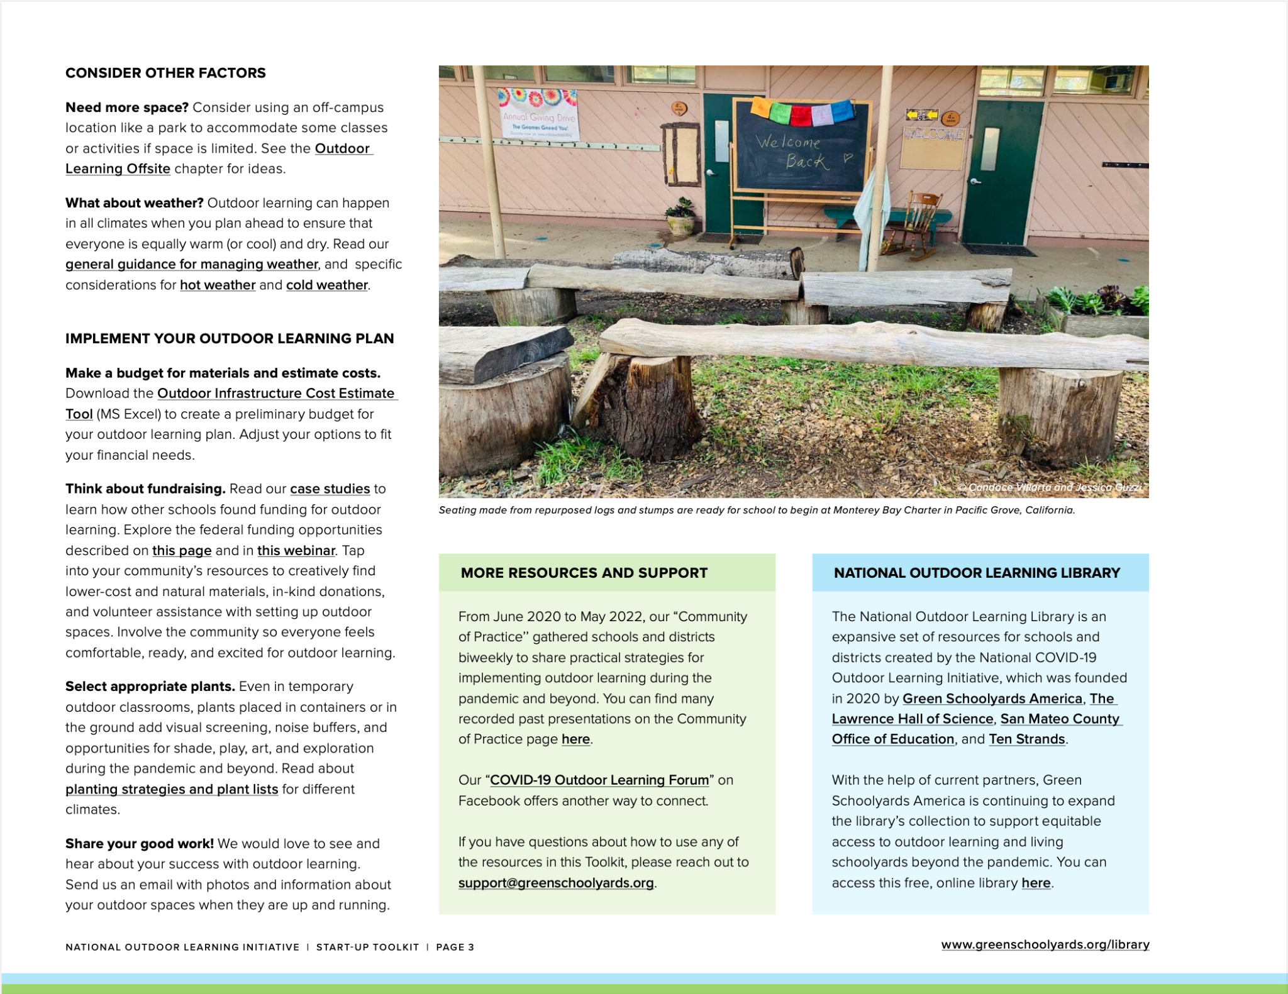
LINKS TO RESOURCES REFERENCED
Page 3
Outdoor Learning Offsite
Outdoor Learning in All Types of Weather
Strategies for Managing Hot Weather
Strategies for Managing Cold Temperatures
Outdoor Infrastructure Cost Estimate Tool (MS Excel)
Outdoor Meals
Inspiring Case Studies
Policy Guidance and Funding
Webinar: Understanding Federal Funds for COVID Relief
Planting Strategies and Plant Lists for Children’s Environments
COVID-19 Outdoor Learning Forum
Community of Practice for Schools and Districts Moving Learning Outside (recorded presentations)
National Outdoor Learning Library

Slide 4
YOUR SCHOOL NAME — Outdoor Learning Diagram
Classroom opportunity #1
Describe location and opportunities.
Add an aerial photo of the school campus
from Google Maps here.
Add a site photo.
Directions:
To use template, you will need to create your own copy.
To use as a Google Slide presentation: Click “File” > “Make a Copy”
To Download as a PowerPoint presentation: Click “File” > “Download” > MS PowerPoint
Add aerial image of school campus from Google Maps.
Add images (e.g., photos of the school grounds you have taken, Augmented Reality Visualizer images you created, or images from Google Street View) that highlight the outdoor learning opportunities. Use lines, arrows, or numbers to point to or reference each location on the aerial photo of the campus.
Add descriptive text for each outdoor learning opportunity.
Use more than one slide if needed.
Remember to get feedback and incorporate suggestions from the school community.
Image © [Image Source]
Classroom opportunity #2
Describe location and opportunities.
Add a site photo.
Image © [Image Source]
Classroom opportunity #3
Describe location and opportunities.
Add a site photo.
Image © [Image Source]
Classroom opportunity #4
Describe location and opportunities.
Add a site photo.
Image © [Image Source]
Image © [Image Source]
Notes:
Directions:
Add aerial image of school campus from Google Maps.
Add images (e.g. photos of the school grounds you have taken, Augmented Reality Visualizer images you created, or images from Google Street View) that highlight the outdoor learning opportunities. Use lines, arrows, or numbers to point to or reference each location on the aerial photo of the campus.
Add descriptive text for each outdoor learning opportunity.
Use more than one slide if needed.
Remember to get feedback and incorporate suggestions from the school community.

Slide 5
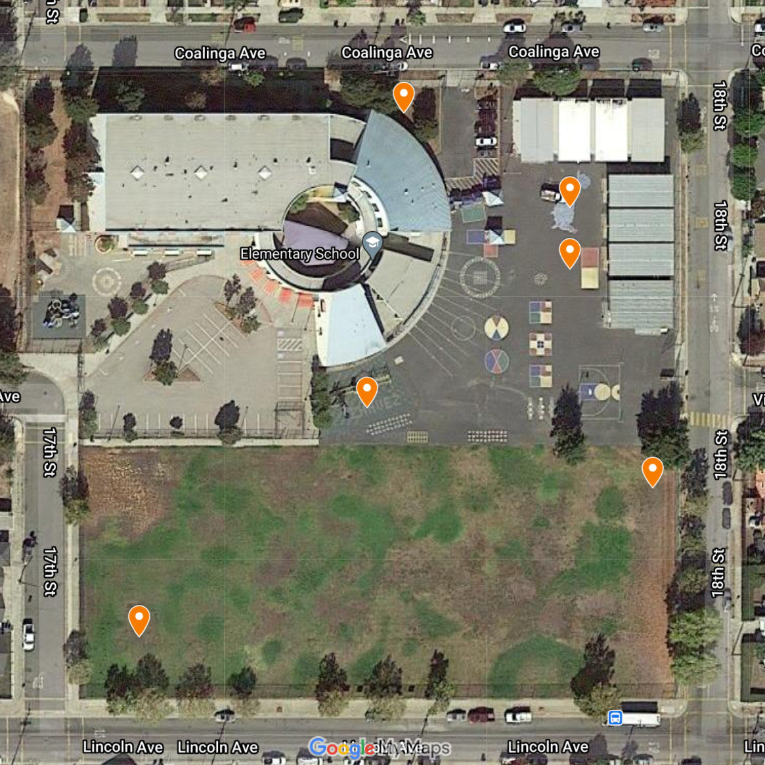
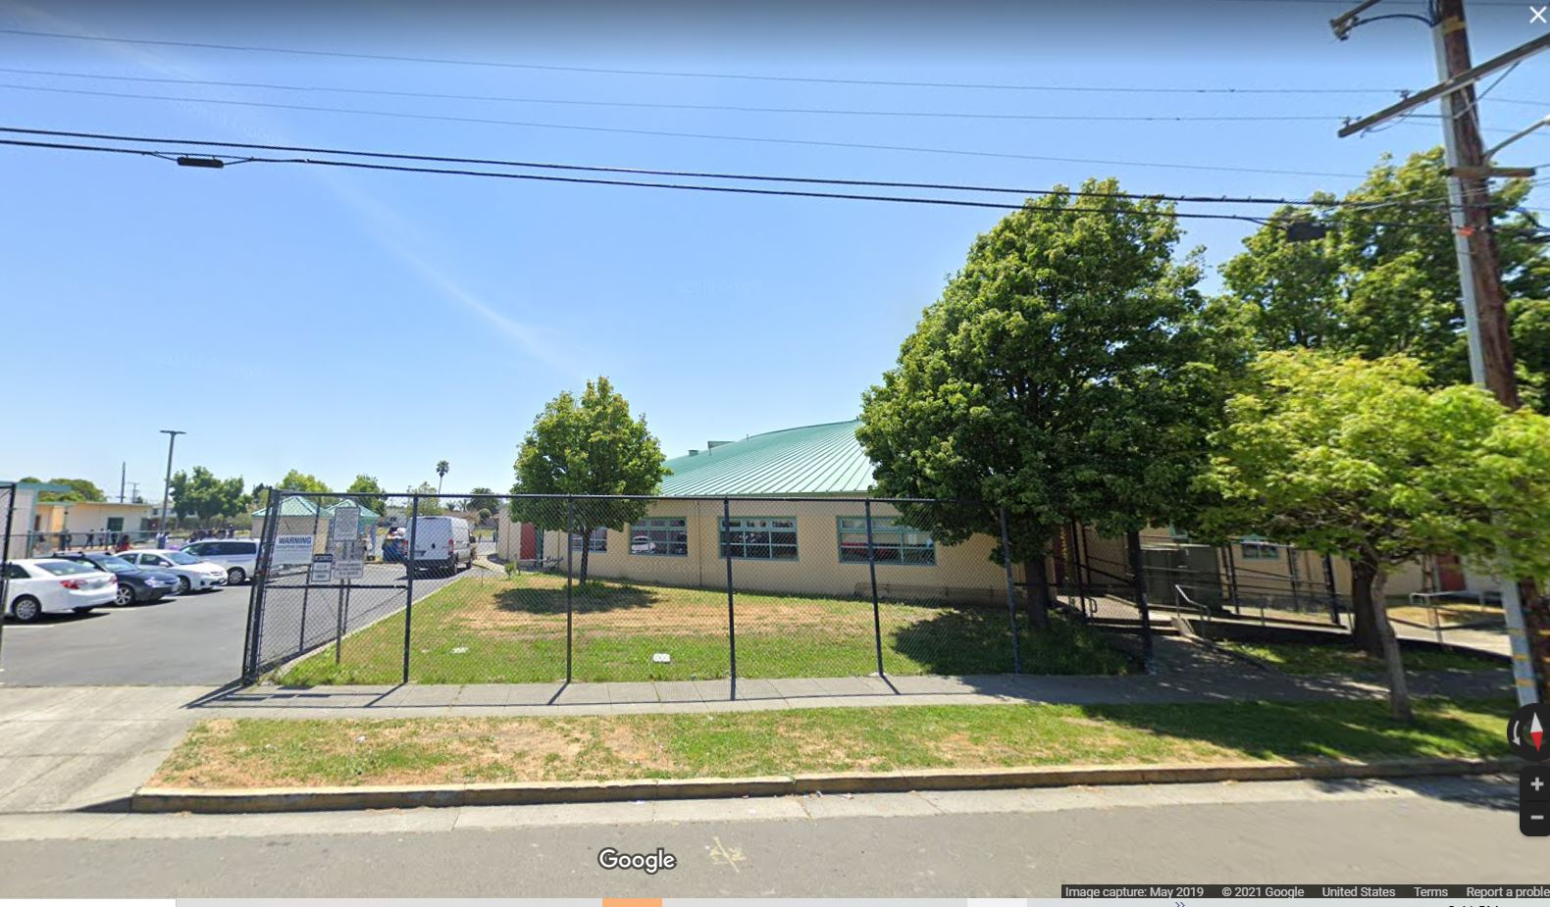
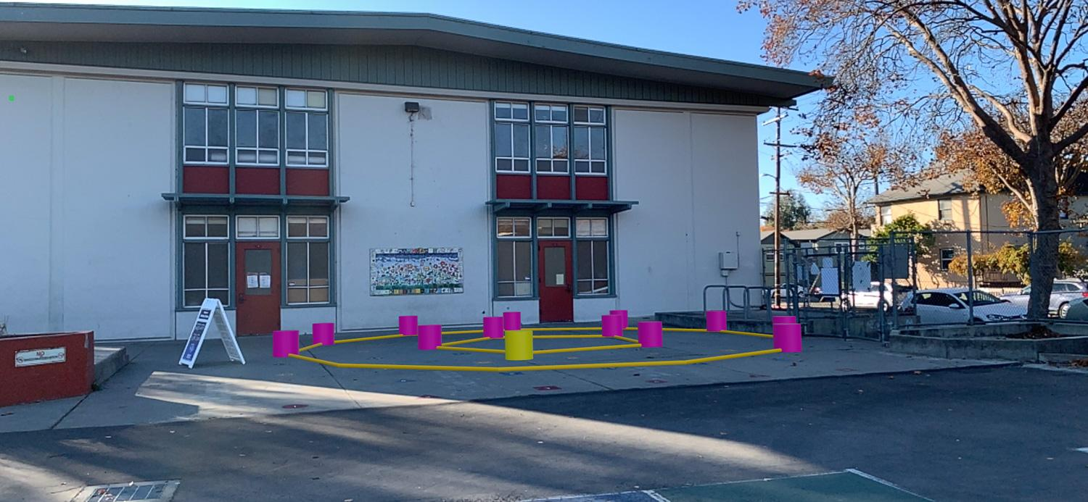
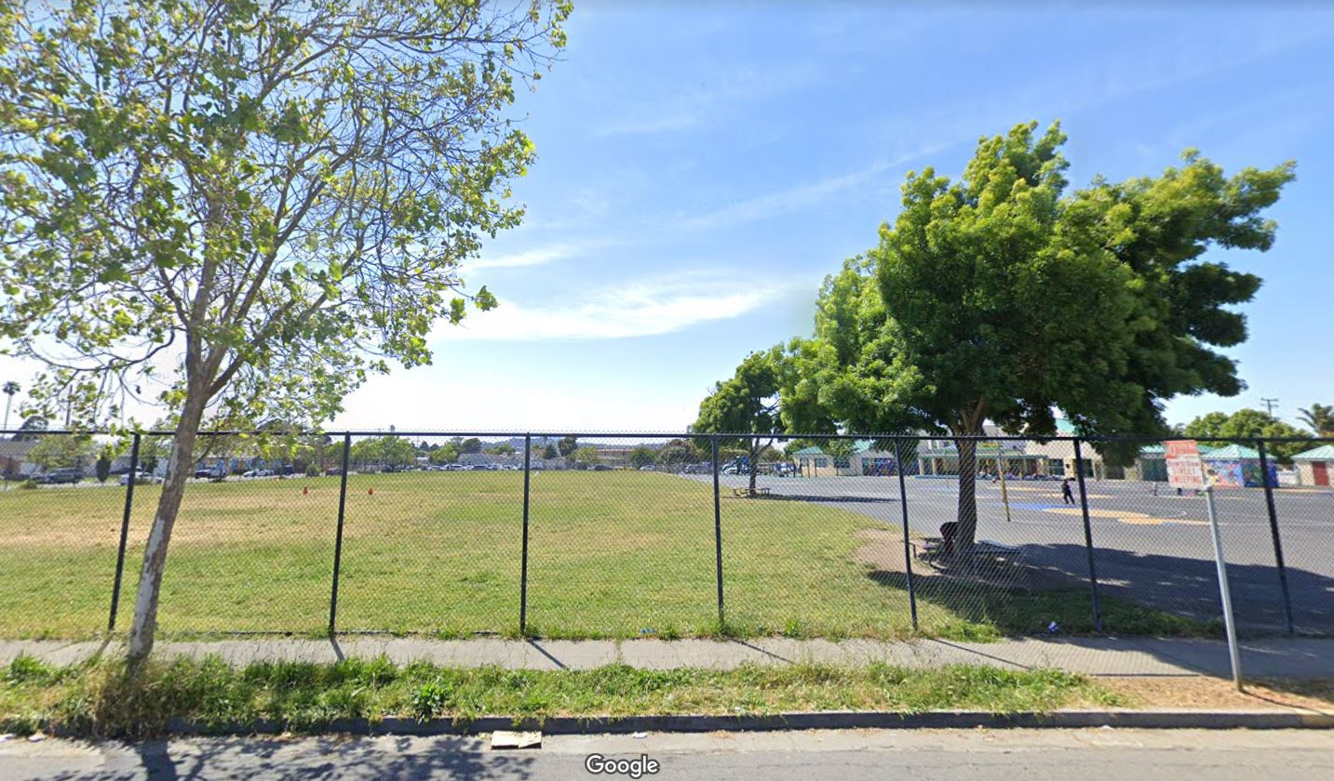
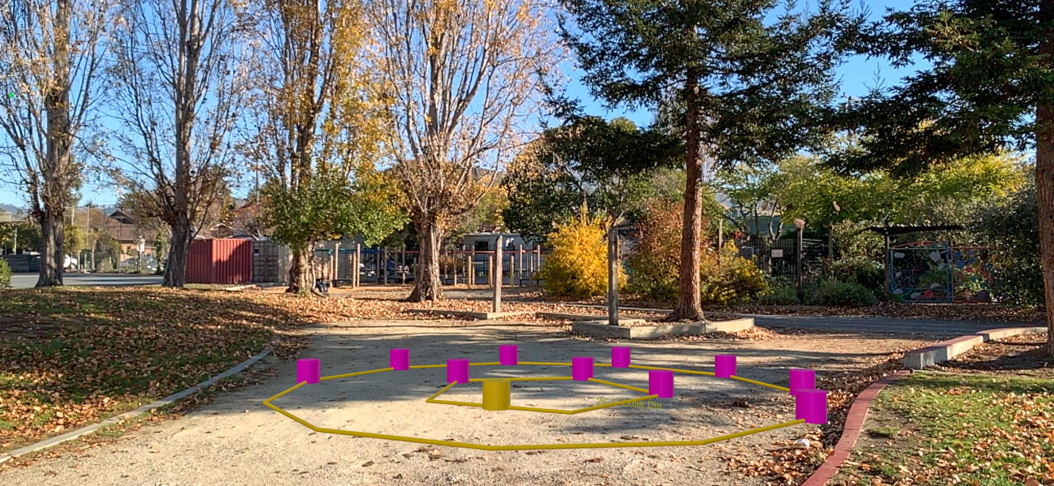
ELEMENTARY SCHOOL — Outdoor Learning Diagram
Classroom opportunity #1
Access to classroom for supplies. Add noise buffer or visual screening with plants along northern edge of campus if needed.
Image © Google Street View
Classroom opportunities #2, 3, 4
Access to classroom, set
up seating in semicircle for
10 students each. Use shade
from building or add tent if needed.
EXAMPLE
Image © Green Schoolyards America
Classroom opportunity #5
Utilize shade from tree or add tent/shade canopy with bucket seating.
Image © Google Street View
Classroom opportunity #6
Set up stumps or bucket seating in semicircle on grass for 10 students. Take advantage of shade from existing trees.
Image © Google MyMaps
Image © Green Schoolyards America

